Slide 1
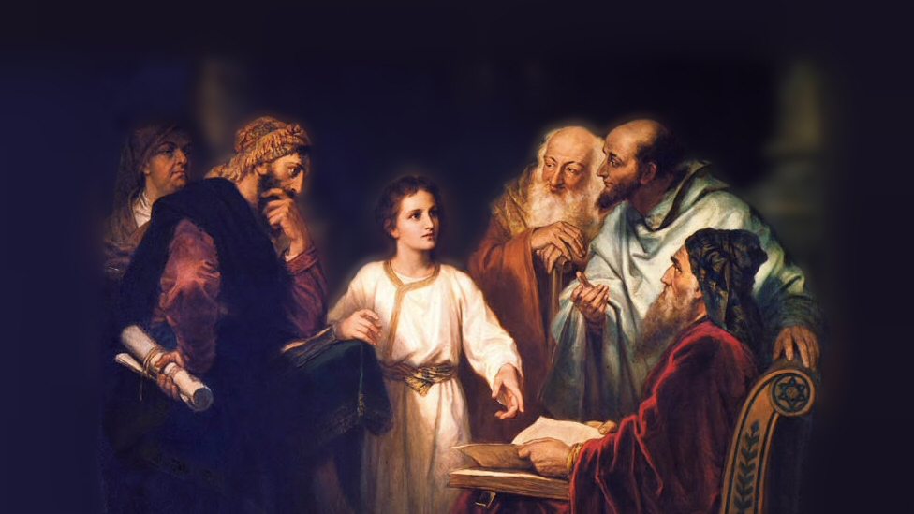
About My Father’s Business
Feeding the 5,000
(John 6:1-14)
Notes:
Matthew Mark and Luke are known as the synoptic gospels
Synoptic – taking a general view of the principal parts of a subject
The same approach – Giving the highlights of Jesus’ life and ministry
John greatly diverges from the other three. As a result, the feeding of the 5,000 is the only miracle that is contained in all four of the gospel accounts.
Matthew 14; Mark 6; Luke 9 and our account here in John 6
(John 6:1-14) READ
Setting: The Sea of Galilee. Matthew informs us that John the Baptist had been killed by Herod. Jesus crossed over to the other side, further way from Herod, who was in the city of Tiberias on the western shore.
(Matthew 14:13), [heard of John’s death], “When Jesus heard it, He departed from there by boat to a deserted place by Himself. But when the multitudes heard it, they followed Him on foot from the cities.”
Occasion: Mark and Luke also mention this was at the return of Jesus’ disciples from their missionary efforts
(Mark 6:30-32), “Then the apostles gathered to Jesus and told Him all things, both what they had done and what they had taught. ³¹ And He said to them, “Come aside by yourselves to a deserted place and rest a while.” For there were many coming and going, and they did not even have time to eat. ³² So they departed to a deserted place in the boat by themselves.”
As Matthew and Mark noted, they could not escape the multitudes who were following Jesus
(John 6:2), “Then a great multitude followed Him, because they saw His signs which He performed on those who were diseased.”
Picture attribution: More Good Foundation (cropped, with background blurred) Creative Commons Liscense
https://www.flickr.com/photos/moregoodfoundation/5135438113

Slide 2
What Jesus Did on This Day
He taught the multitude (Mark 6:34; Luke 9:11)
John 7:45-47
Notes:
What Jesus did on this day is a microcosm of His entire ministry, showing His authority, His divinity, His compassion, and His purpose for coming to this world!
[CLICK] He Taught the Multitude
His teaching is not recorded by John, but is by Mark and Luke
(Mark 6:34), “And Jesus, when He came out, saw a great multitude and was moved with compassion for them, because they were like sheep not having a shepherd. So He began to teach them many things.”
“like sheep not having a shepherd” (Shepherdless sheep wander without the shepherd’s voice to guide them!)
(Luke 9:11), “But when the multitudes knew it, they followed Him; and He received them and spoke to them about the kingdom of God, and healed those who had need of healing.”
(John 7:45-47), [Religious leaders had sent officers to bring Jesus to them. These men went, and witnessed Jesus teaching the people], “Then the officers came to the chief priests and Pharisees, who said to them, “Why have you not brought Him?” ⁴⁶ The officers answered, “No man ever spoke like this Man!” ⁴⁷ Then the Pharisees answered them, “Are you also deceived? ⁴⁸ Have any of the rulers or the Pharisees believed in Him?”
Jesus words convinced those whose hearts were open to truth.
He spoke with authority

Slide 3
What Jesus Did on This Day
He taught the multitude (Mark 6:34; Luke 9:11)
John 7:45-47
He healed many (Matthew 14:14; Luke 9:11)
James 1:27; Hebrews 2:3-4
Notes:
Again, John’s gospel does not mention the miracles Jesus performed BEFORE the feeding of the 5,000. However, Matthew and Luke do…
(Matthew 14:14), “And when Jesus went out He saw a great multitude; and He was moved with compassion for them, and healed their sick.”
Motivation: Compassion. It is important that we be aware of, and act with compassion towards the unfortunate. This is what it means to be a disciple of Jesus Christ.
(James 1:27), “Pure and undefiled religion before God and the Father is this: to visit orphans and widows in their trouble, and to keep oneself unspotted from the world.”
(Luke 9:11), “But when the multitudes knew it, they followed Him; and He received them and spoke to them about the kingdom of God, and healed those who had need of healing.”
We note again, the healings were evidence that Jesus derived his authority from God!
(Hebrews 2:3-4), “How shall we escape if we neglect so great a salvation, which at the first began to be spoken by the Lord, and was confirmed to us by those who heard Him, ⁴ God also bearing witness both with signs and wonders, with various miracles, and gifts of the Holy Spirit, according to His own will?”

Slide 4
What Jesus Did on This Day
He taught the multitude (Mark 6:34; Luke 9:11)
John 7:45-47
He healed many (Matthew 14:14; Luke 9:11)
James 1:27; Hebrews 2:3-4
He fed a multitude (8-13)
1 Kings 17:16; 2 Kings 4:44
Notes:
(John 6:8-13), “One of His disciples, Andrew, Simon Peter's brother, said to Him, ⁹ “There is a lad here who has five barley loaves and two small fish, but what are they among so many?” ¹⁰ Then Jesus said, “Make the people sit down.” Now there was much grass in the place. So the men sat down, in number about five thousand. ¹¹ And Jesus took the loaves, and when He had given thanks He distributed them to the disciples, and the disciples to those sitting down; and likewise of the fish, as much as they wanted. ¹² So when they were filled, He said to His disciples, “Gather up the fragments that remain, so that nothing is lost.” ¹³ Therefore they gathered them up, and filled twelve baskets with the fragments of the five barley loaves which were left over by those who had eaten.”
Andrew’s words establish the meagerness of their store. (5 loaves and two small fish, to feed a multitude that consisted of 5,000 men, not mentioning any women and children).
Jesus, after directing the multitude to sit, offered up a prayer to God
There is an interesting difference in the terms used by John, and then by the other writers
John: (eucharisteo) – eucharist (Catholic – sacrament/communion)
Others: (eulogeo) – “lit. to give thanks”
This indicates that the term, as used by John, did not have the same connotation as the use of that term in later centuries.
After distribution, all were filled, and 12 baskets of excess were gathered.
The magnitude of the miracle brings to mind Old Testament examples…
(1 Kings 17:16), [Elijah instructed a widow lady, during famine, to prepare him a meal from the last of her stores. Her intention was to feed her son a final time, then for them to die. He promised her in return provision throughout the famine], “The bin of flour was not used up, nor did the jar of oil run dry, according to the word of the Lord which He spoke by Elijah.”
(2 Kings 4:44), [Elisha commanded his servant that 20 loaves of bread be set before 100 men with the promise, ‘They shall eat and have some left over], “So he set it before them; and they ate and had some left over, according to the word of the Lord.”
Whether great or small, the miraculous serves to proves that Jesus had His authority from God. But, this was an astounding example of His power

Slide 5
What Jesus Did on This Day
He taught the multitude (Mark 6:34; Luke 9:11)
John 7:45-47
He healed many (Matthew 14:14; Luke 9:11)
James 1:27; Hebrews 2:3-4
He fed a multitude (8-13)
1 Kings 17:16; 2 Kings 4:44
He convinced them He was “the Prophet” (14)
Deuteronomy 18:15; Hebrews 1:1-4
Notes:
The magnitude of the miracle was persuasive. It as a convincing argument that Jesus was “truly the Prophet who is to come into the world” (John 6:14)
Notice: “the” prophet, not “a” prophet.
This is found, not because a specific word “the” is found in the Greek. The literal reading would be… “This is true, prophet to come into the world.”
But, the context clearly shows this to be a Messianic reference!
This material so strongly demonstrated that Jesus was from God
It was exponentially greater than the miracles of Elijah or Elisha. Or even the supplying of manna and quail in the wilderness.
Moses spoke of “that prophet” which would be “like” Moses, the first lawgiver…
(Deuteronomy 18:15), “The Lord your God will raise up for you a Prophet like me from your midst, from your brethren. Him you shall hear”
(Hebrews 1:1-4), “God, who at various times and in various ways spoke in time past to the fathers by the prophets, ² has in these last days spoken to us by His Son, whom He has appointed heir of all things, through whom also He made the worlds; ³ who being the brightness of His glory and the express image of His person, and upholding all things by the word of His power, when He had by Himself purged our sins, sat down at the right hand of the Majesty on high, ⁴ having become so much better than the angels, as He has by inheritance obtained a more excellent name than they.”

Slide 6
Conclusion
Jesus came to earth to save the world!
He is the Son of God, who cares for and loves His creation!
Notes:
This miracle and the events surrounding prove the truthfulness of these things in an amazing and powerful way!

